Slide 1
Towards Geospatial Intelligence with AI
Shreya Sharma
Data Science Researcher, NEC Corporation

Slide 2
What is Geospatial Intelligence?
Remote sensing
Computer Vision
Deep Learning
Making computers to see the world as humans
Learn patterns through lots of examples
Taking measurements of the Earth from a distance
tool to provide Earth observation images (just like you take from your camera in an airplane!) add your Russia picture
GI

Slide 3
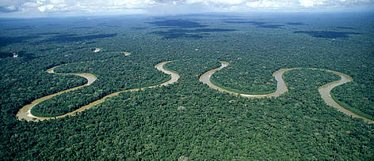

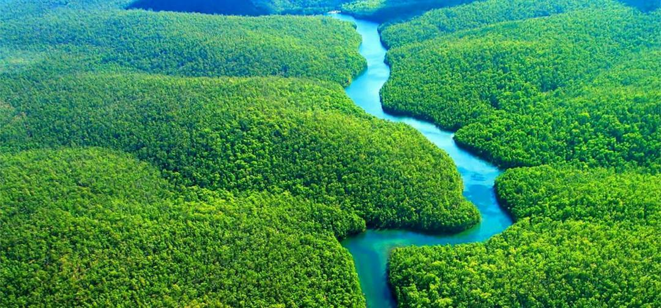

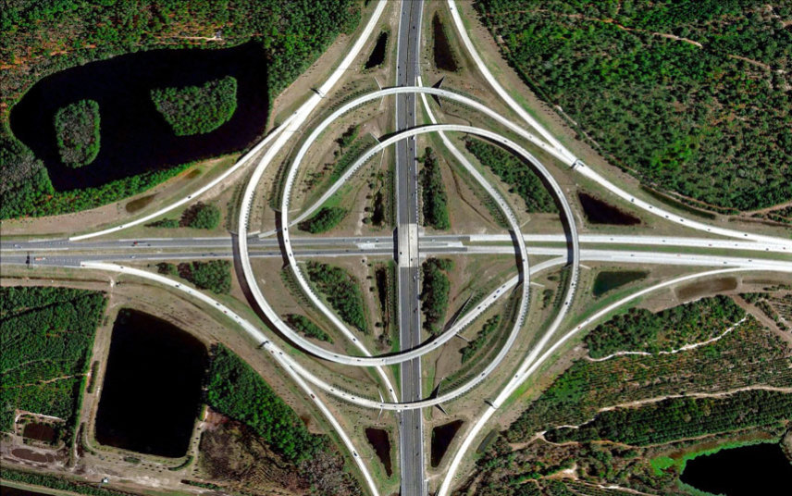
Why do we care?
Currently only 25% of the Earth’s surface is seen by ground sensors
Remote sensing (Satellite Earth Observation) is ‘Eye from the Sky’
Notes:
But how does this eye see?

Slide 4

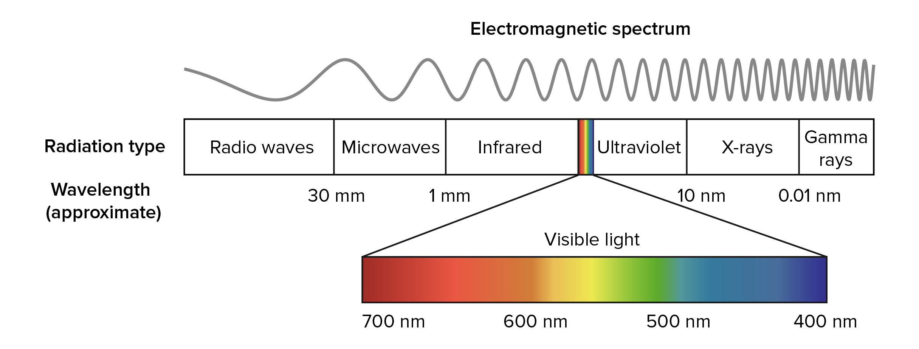




How we see earth?
Notes:
For this, lets first understand how we see the earth. We see the world in the visible spectrum – which is colourful and beautiful.

Slide 5
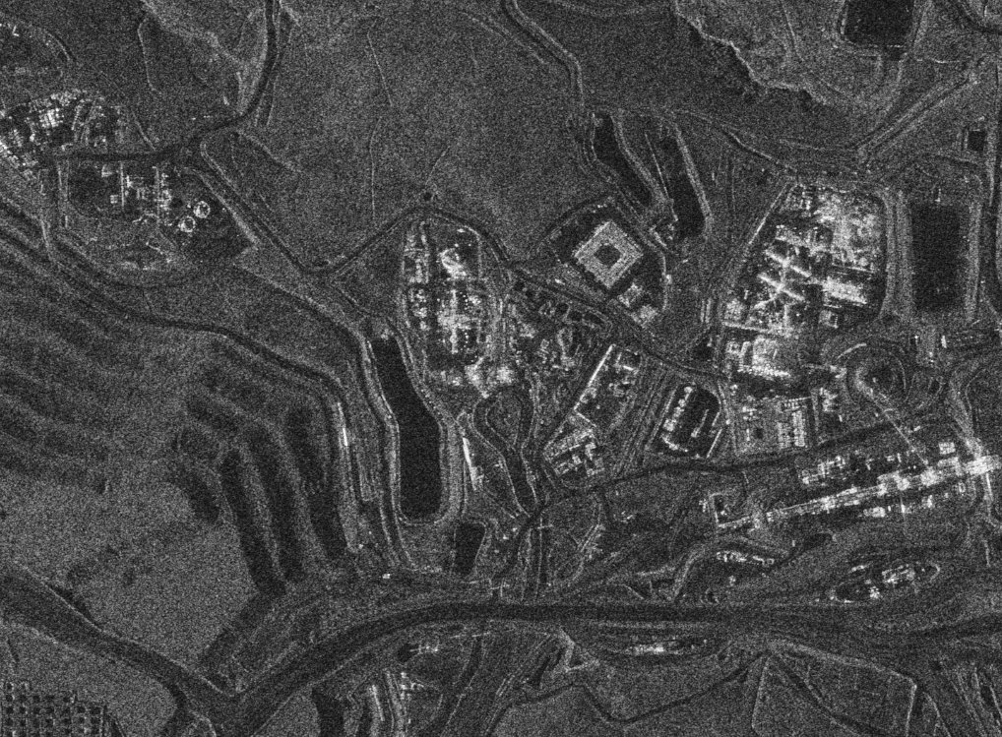
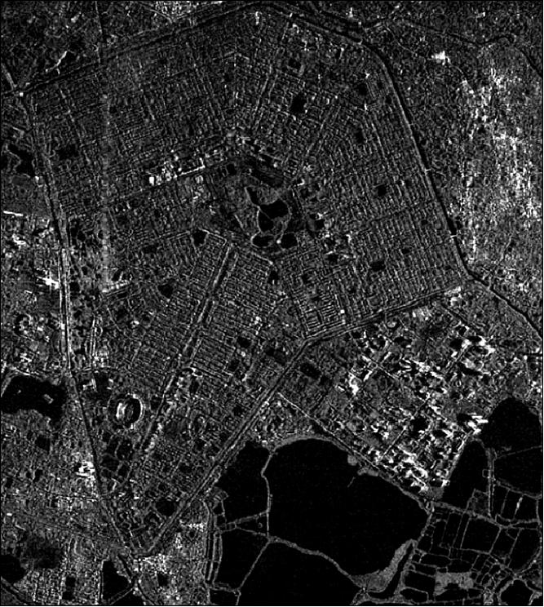
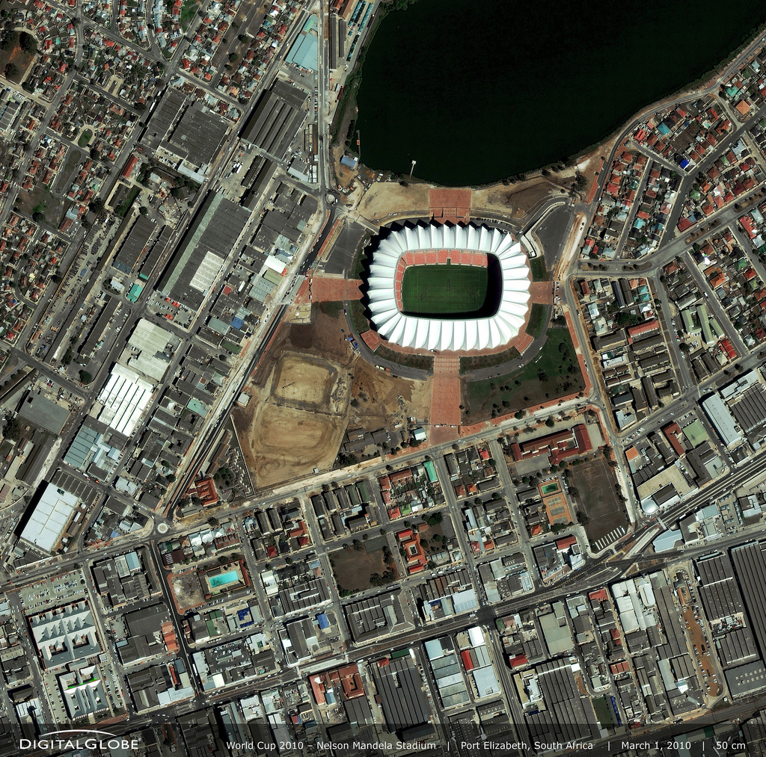
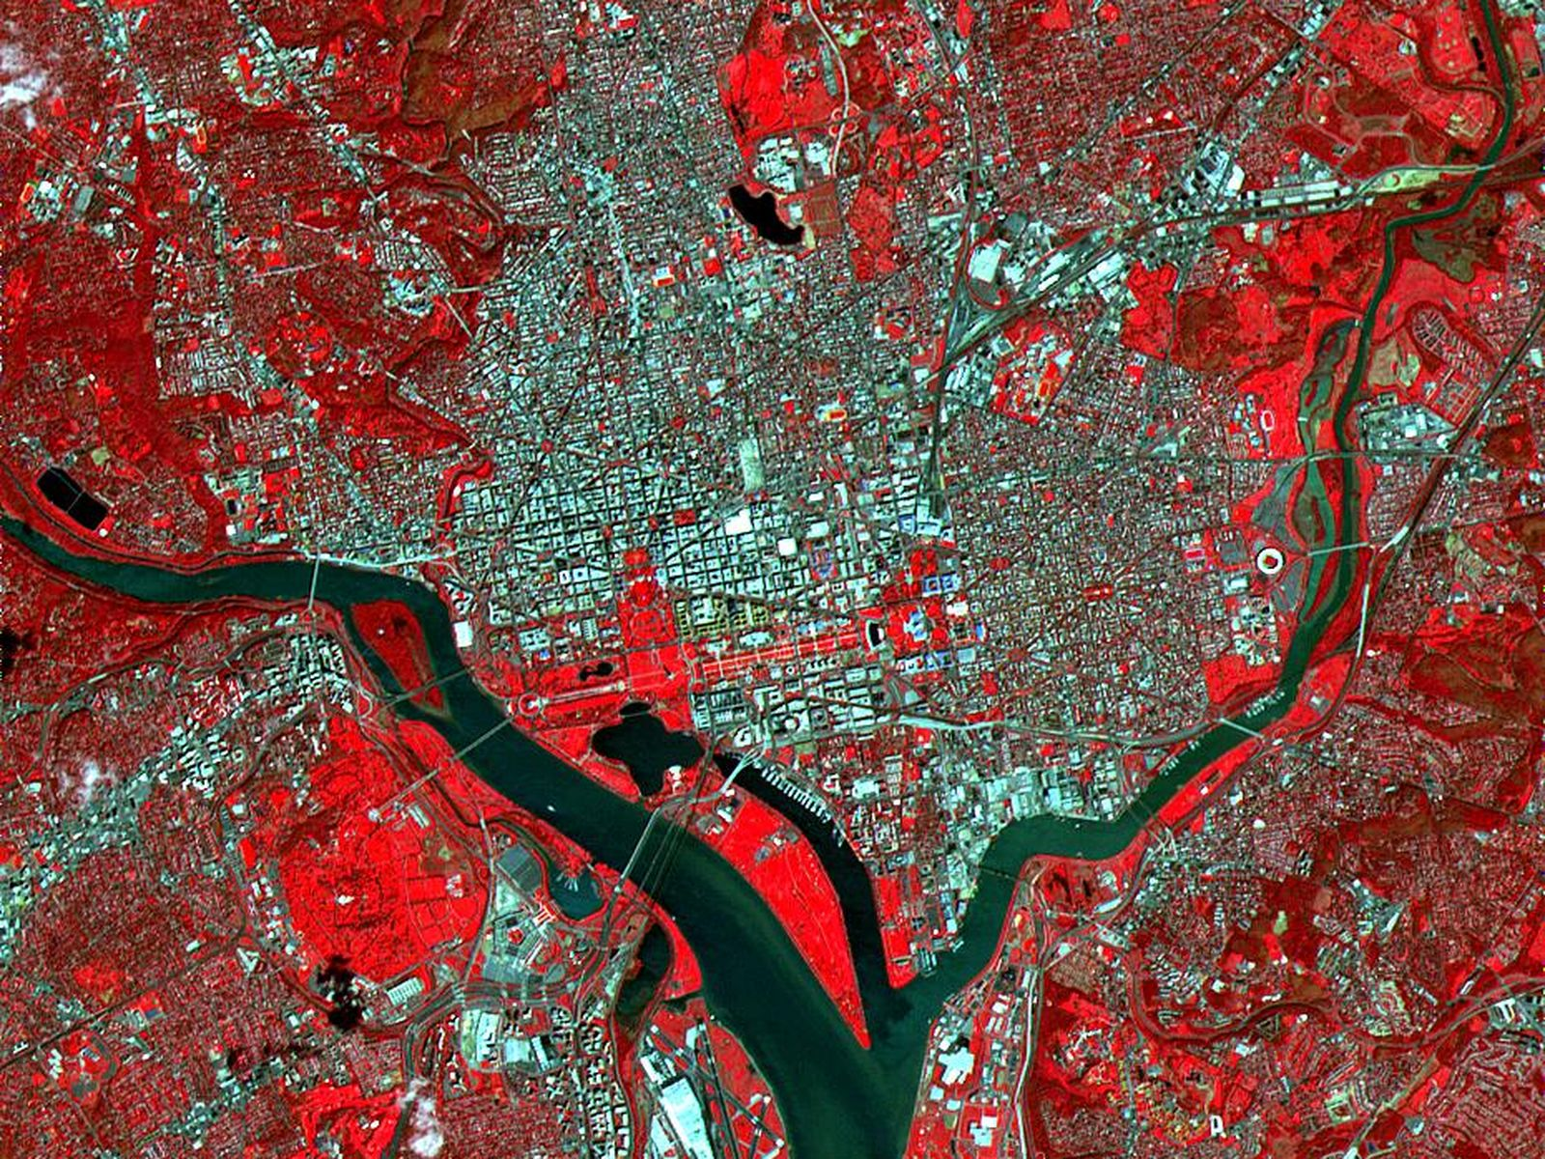
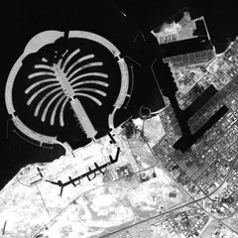
How EO sees earth?
Gray-scale
RGB
RGB + IR
Microwave
©DLR
Microwave
VISIBLE+INFRARED
VISIBLE
Panchromatic
©RISAT
©NASA
Notes:
But remote sensing sees earth not just in visible spectrum but in all other bands providing us unique views of our planet
For example:
Rgb
Infrared
Multispectral
Hyperspectral
SAR
Lidar
Each of the datasets has its own advantage and used as per the application. My research work is on microwave images.

Slide 6
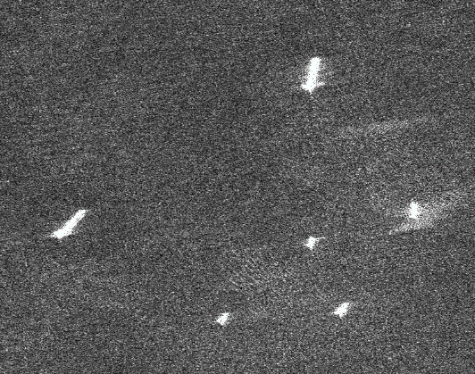
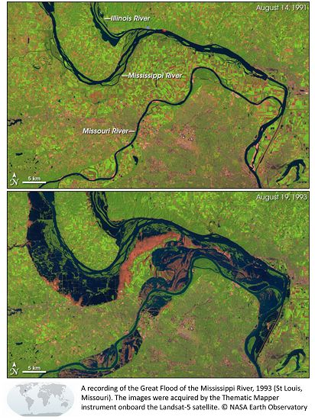
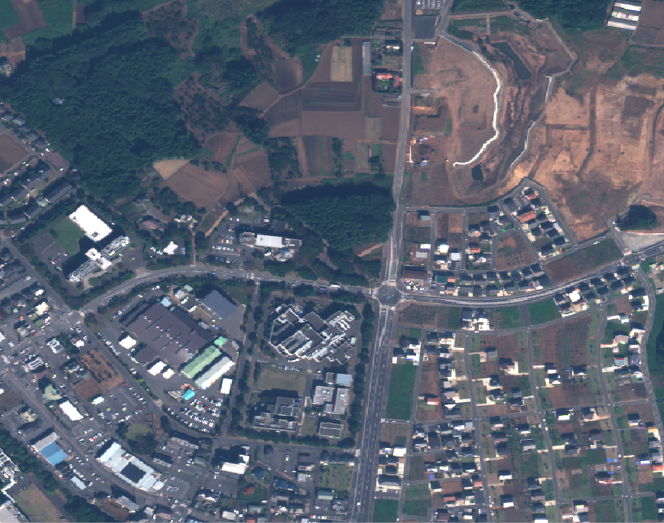
Applications
Surveillance
Disaster Mgmt.
Infrastructure
Cargo
Before
Fishery
Tanker
Fishery
After
Tug
Cargo
So many datasets…
DeepGlobe
BigEarth
Functional map of the world
SpaceNet
Kaggle Amazon Forest
Notes:
With so many satellite missions being launched each year, remote sensing datasets have boomed for example……and we can use this datasets for finding the patterns of life such as…
Infact this area is becoming so popular that Kaggle hosts so many competetions with geospatial data
(100+ startups have boomed in this field globally)
‘’’’
These datasets can be used for wide variety of applications across industries such as… Deep learning plays a critical role in extracting these patterns.

Slide 7
My Research Work
Ship Classification
Change Detection (brief)
©RISAT
Microwave Image =>
Notes:
With that as the background, today I will present you my reseach work on 2 real world application –ship classification and change detection using earth observation data.
Out of the datasets that I showed, I work with microwave images and build deep learning models

Slide 8
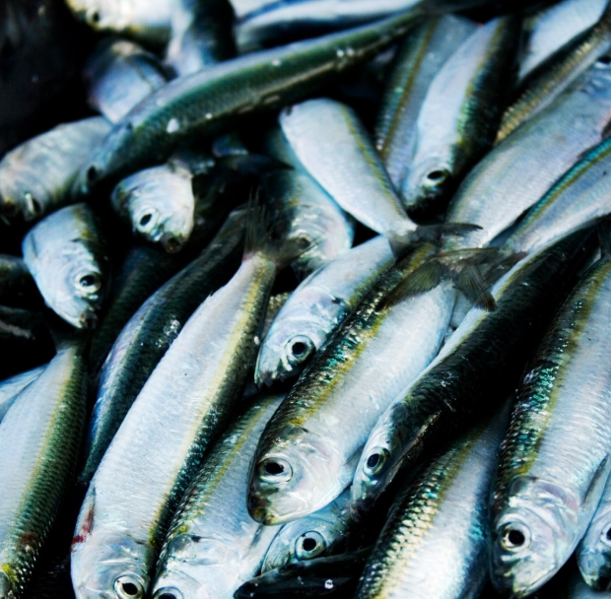
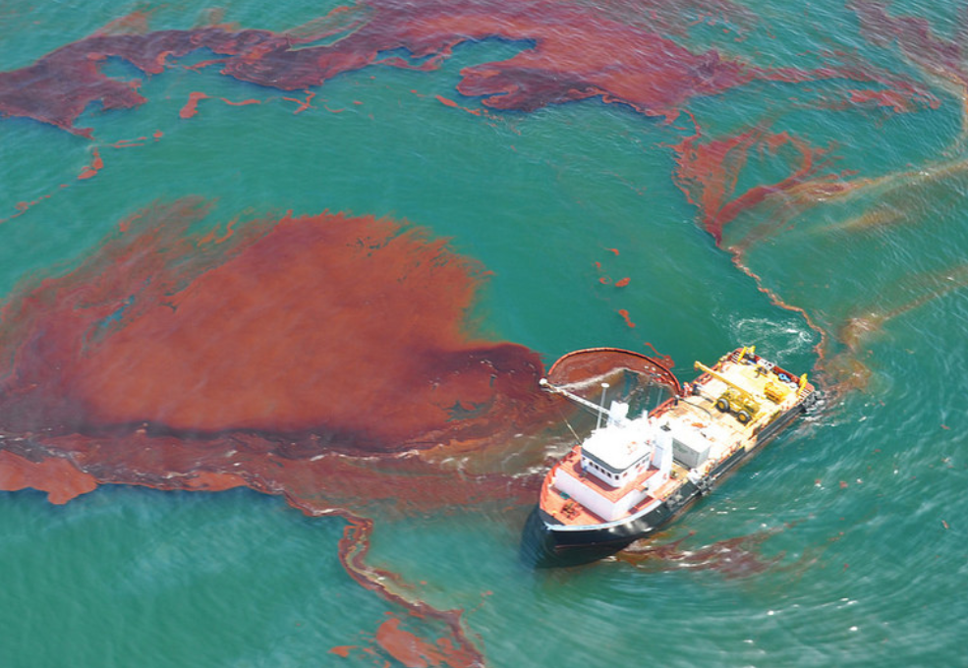
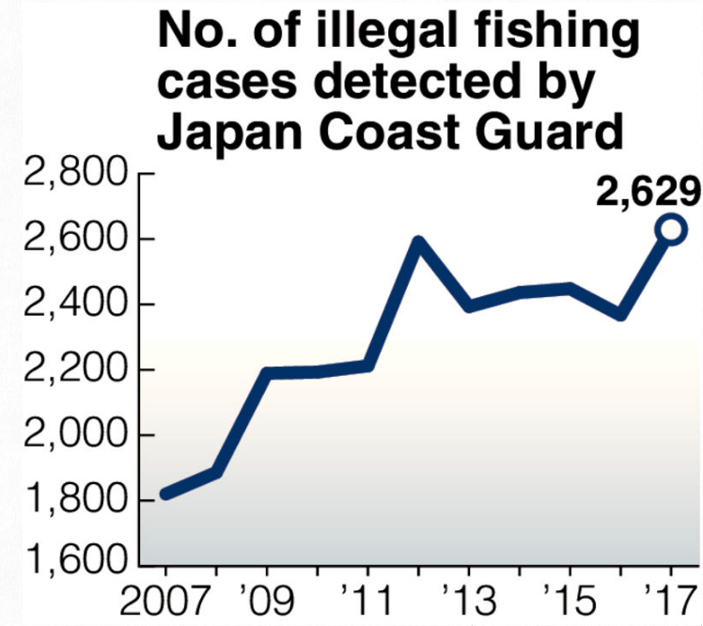
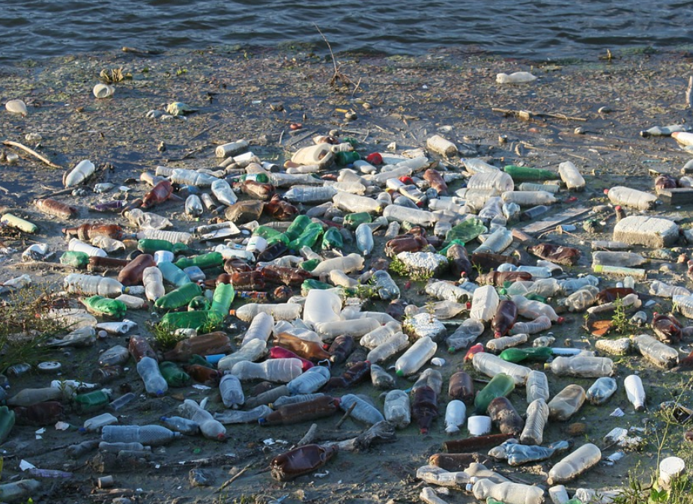
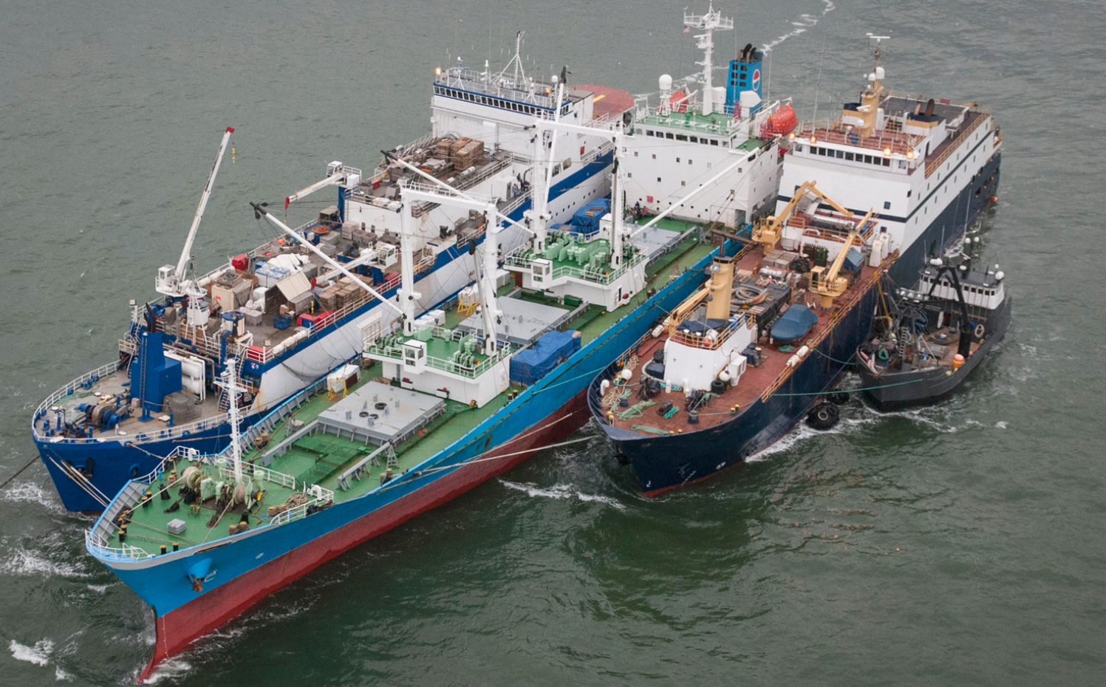
Motivation
Ship classification is a key application in of maritime surveillance
Helps in quick identification of ships involved in illegal activities
Overfishing
Oil-spills
© NOAA/CC BY 2.0
Garbage dump
Smuggling
©Yomiuri Shinbun, 28/02/2018
© Nature Magazine
Microwave image is very useful as it is ‘cloud-free’ and image even in night

Slide 9
Existing SAR Ship Classification Methods
1. Hand-crafted Features (HCF)-based
Bounding Box
Pros
Intuitive features
Cons
Requires expert knowledge of ships
Feature*
extractor
Classifier
(SVM)
Class
© JAXA
*Length, Area, Intensity, … etc.
2. Convolutional Neural Network (CNN)-based
Pros
Does not require expert knowledge
Cons
Requires huge training data
CNN
Class
© JAXA
These methods classify a ship based on its appearance

Slide 10
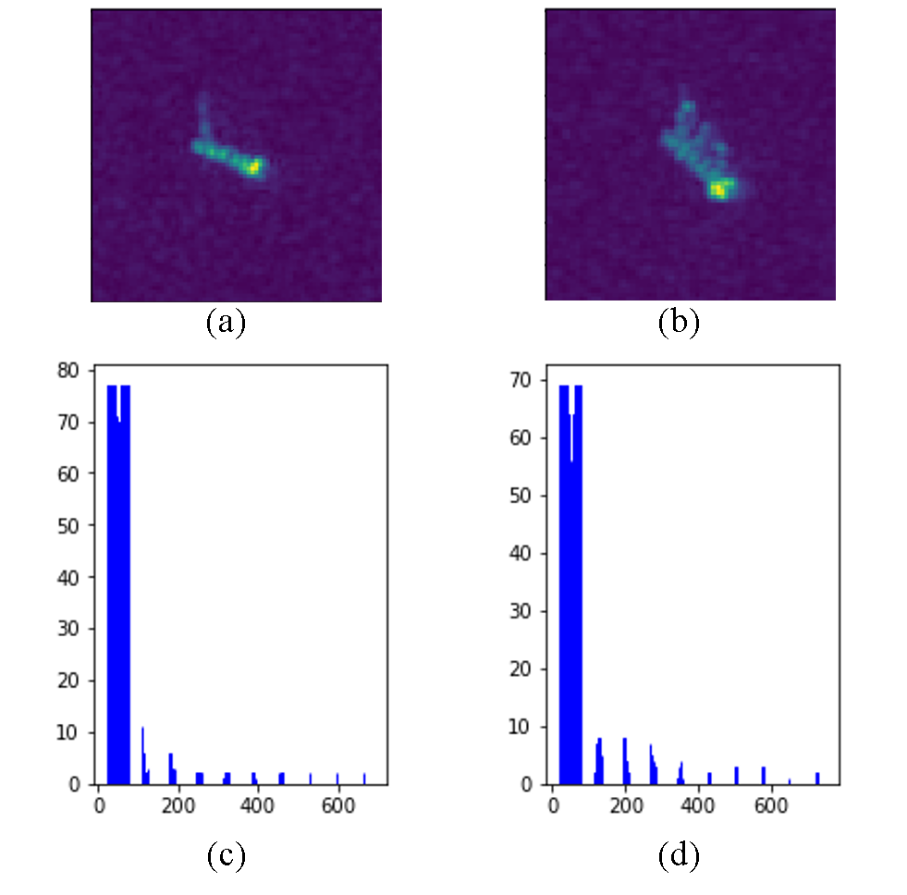




Problem
Appearance of a ship varies with satellite viewing angle
Example:
Labelled images are very few to learn all possible variations
$θ_{1}$= ${30}^{°}$
SAR
Range
$$θ_{1}$$
$$θ_{2}$$
Same ship viewed under different angles
© JAXA
$θ_{2}$= ${40}^{°}$
Azimuth
© JAXA
Only image information is insufficient for robust recognition
Appearance information is not sufficient to achieve robust classification
Notes:
Explain briefly what is SAR geometry
For cnn to learn all these variations, huge training data is required, but it is not available in SAR.

Slide 11
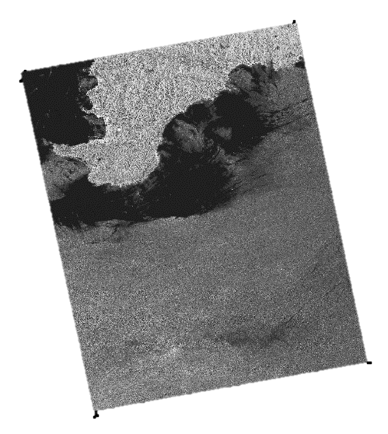

Proposed Method
Use viewing angle as an additional information in a NN
Helps the neural network follow the appearance changes by learning an implicit relationship
SAR
Ship Images
Neural Network
Ship Type
© JAXA
© JAXA
Viewing angle map
Shows viewing angle at each pixel
Metadata
Extract Viewing Angle Map
$${40}^{°}$$
$${25}^{°}$$
Sharma et al., CNN-based ship classification method incorporating SAR geometry information, SPIE RS 2018.

Slide 12
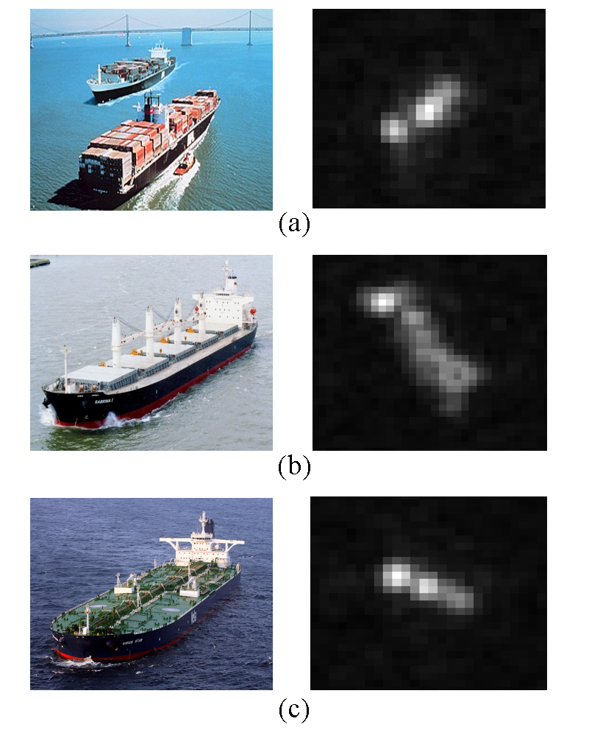
Experimental Set-up
Dataset: OpenSARShip*
Specifications
Satellite | Sentinel-1
Resolution | 20m
Polarization | HH
Image size | 128x128
No. images | 200/class
Ground truth | AIS + Marine Traffic
Container
© ESA
© NOAA
© ESA
Bulk-carrier
© ESA
Conventional Methods
Tanker
HCF | 10 Features + SVM
CNN | w/o incident angle
© ESA
© ESA
*Huang, L et al., "OpenSARShip: A dataset dedicated to Sentinel-1 ship interpretation," IEEE Journal of Sel. Top. in App. Earth Obs. and Rem. Sen. 11(1), 195-208 (2018).

Slide 13
Experimental Result
Proposed method outperforms the conventional method
4.2% improved f-measure
25% reduced training data requirement
© ESA
Same Acc.
© ESA
© ESA

Slide 14
Demo

Slide 15
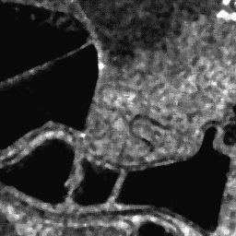
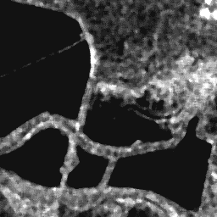
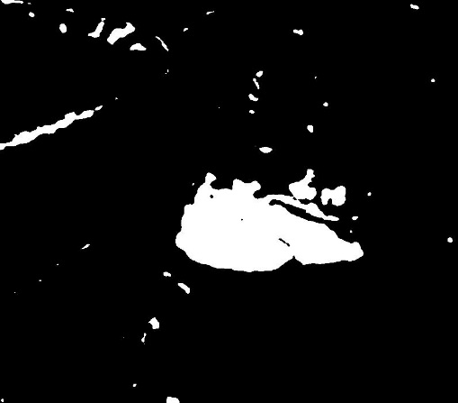
Change Detection - Motivation
Change detection enables us to understand dynamics of our planet
SAR images provide reliable visual evidence to detect changes
Image 1
Image 2
Change Map

Slide 16
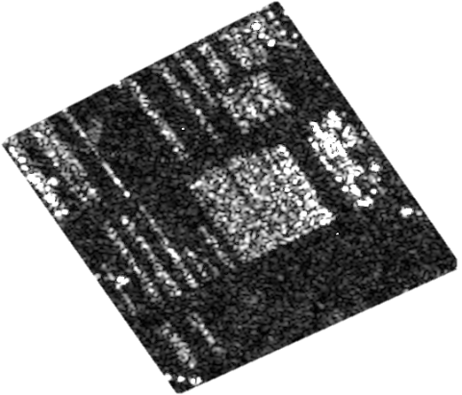
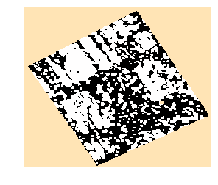
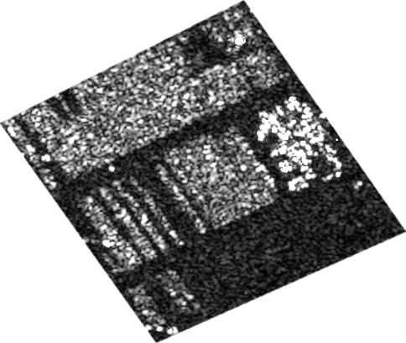
Conventional Method
Based on pixel-to-pixel difference followed by classification
Change Map
Pixel-to-pixel difference
Classification
Problem: Many False Changes in high resolution images!

Slide 17
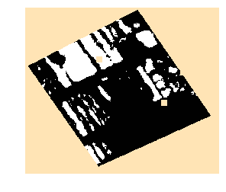
Proposed Method
Transform the images into features and compute distance between features
Siamese Network
Encoder
Distance Calculation
Classification
Share Weights
Encoder
Sharma et al., Very high resolution SAR change detection with Siamese Networks, The 66th Academic Conference of the Remote Sensing Society of Japan, 2019.

Slide 18
Experimental Evaluation
Specifications
Application
Parking Lot Monitoring
Baselines:
PCA + Kmeans [1]
Sparse AE + Kmeans [2]
Evaluation Metrics
f-measure
ROC-AUC
[1] T. Celik: Unsupervised change detection in satellite images using principal component analysis and k-means clustering, IEEE Geoscience and Remote Sensing Letters, vol. 6, no. 4, pp. 772-776, 2009.
[2] M. Gong., H. Yang, and P. Zhang: Feature learning and change feature classification based on deep learning for ternary change detection in SAR images, ISPRS Journal of Photogr. and Remote Sensing, no.129, pp.212-225, 2017.
Satellite | TerraSAR-X
Resolution | 1m
Polarization | HH
No. of parking sites | 5
No. of images/site | 10
No. of pairs/site | 9
Patch sizes | 10x10, 16x16
Ground Truth (GT) | Manual interpretation

Slide 19
Dataset
…
t0
t1
t2
t8
t9
…
Site 1
…
Site 2
…
…
Site 3
Site 4
…
All images are copyrighted to DLR
…
Test
Site 5
Pair 1
Pair 2
Pair 9

Slide 20
Result [1/2] : f-measure
Siamese networks outperforms the conventional methods
+0.4
+0.25

Slide 21
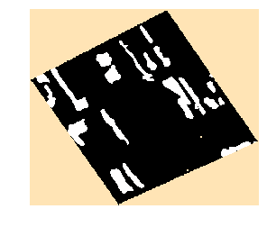
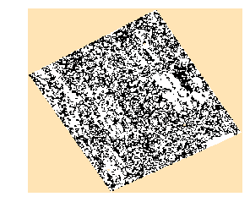
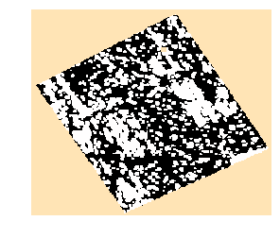
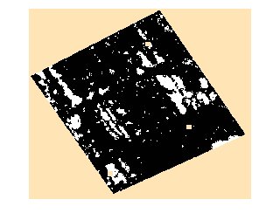
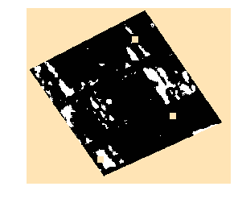
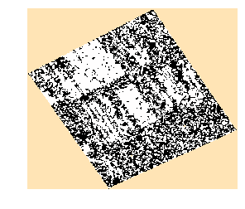
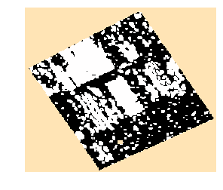
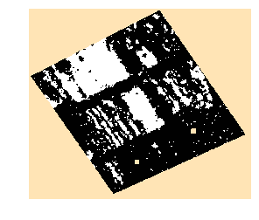
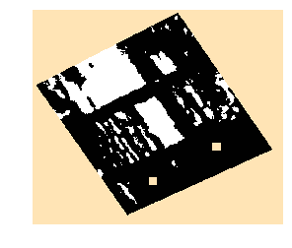
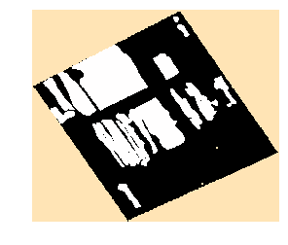
Result [2/2] : Change Maps
Siamese networks produce visually better change maps
Test Pair 1
GT
PCA-K
SAE-K
Siamese-10
Proposed
Test Pair 2
GT
PCA-K
SAE-K
Siamese-10
Siamese-16

Slide 22
Conclusion

Slide 23
Contents
What is geospatial intelligence?
Motivation
Electromagnetic Spectrum [1/2]
Electromagnetic Spectrum [2/2]
Applications
2 applications (just intro)
Ship recognition- motivation
Existing methods
Problem
Proposed method
Experimental Evaluation
Result
Demo
Change detection
Conventional method and problem
Proposed method
Experimental Evaluation
Dataset
Result – 1
Result – 2
Conclusion
Notes:
20 mins -> 15 slides

